Slide 1
Personal Dream Informatics A Self-Information Systems Model of Dream Engagement
Michael Hoefer, Bryce Schumacher, and Stephen Voida
University of Colorado Boulder

Slide 2
Dreaming is a universal phenomenon
Notes:
nightmares are prevealent (9-14% monthly nightmares, 5% on a weekly basis)

Slide 3
Dream science has a ways to go...
and...

Slide 4
HCI can play a fundamental role

Slide 5
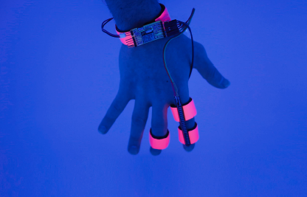
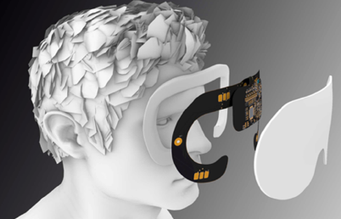
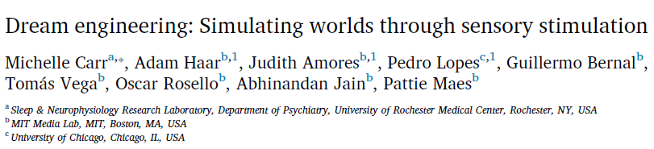
To engineer?

Slide 6
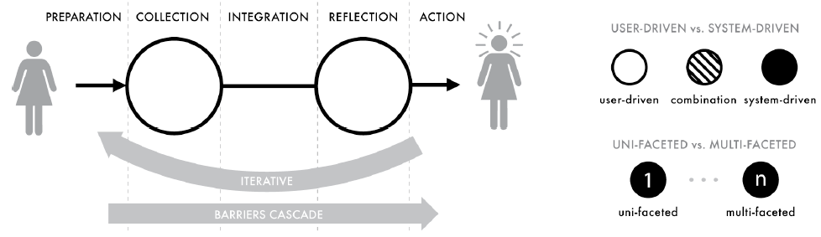
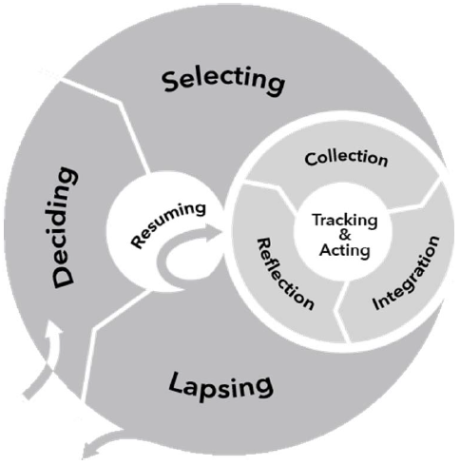
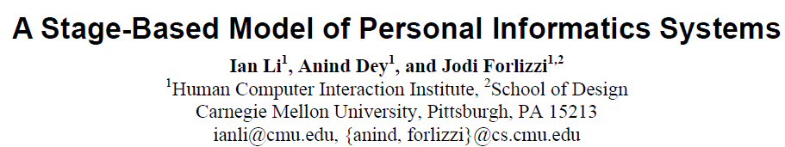
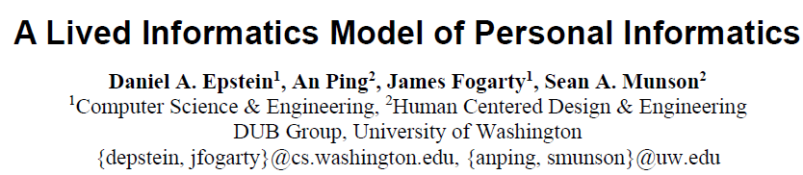
Or to foster engagement?

Slide 7
Or to foster engagement?
and

Slide 8
Personal Dream Informatics

Slide 9
Dreaming as a
self-information system
RQ1: How can current dream information systems be characterized? What are the components and processes they maintain?
RQ2: What are the outcomes of dream information systems? What are the benefits and downsides of dream tracking? Why are individuals motivated to cultivate and maintain these systems?
RQ3: How can dream information systems be improved? What role(s) could new technology play in improving dream information systems?

Slide 10

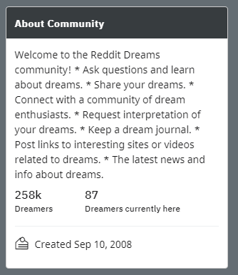

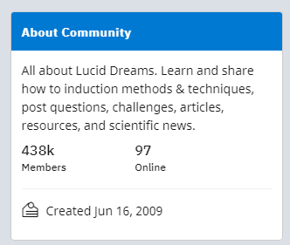
Superusers of dreams

Slide 11
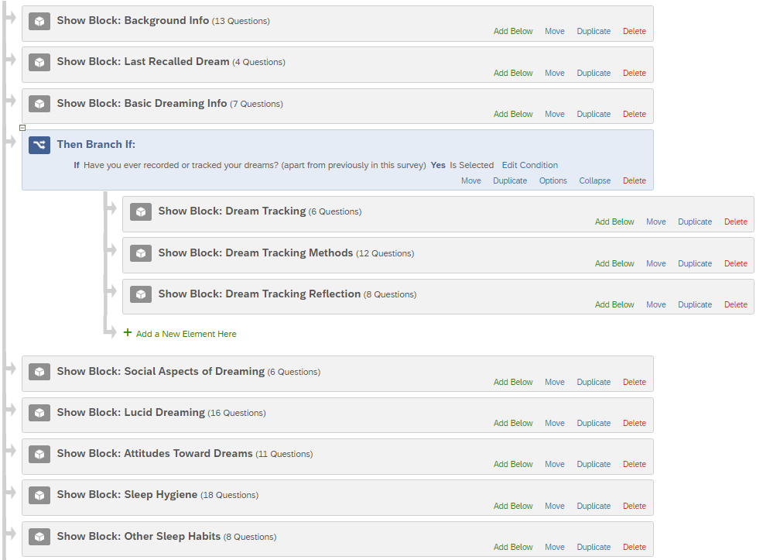
Survey
n=281
(~50% super users)

Slide 12
Why track dreams?
Due to having vivid dream experiences (33%)
Learn to lucid dream (19%)
Better remember dreams (16%)
Better understand oneself (16%)
“I'm not quite sure [why I started tracking dreams] to be honest. I think I started to feel that sometimes there were moments, visions, feelings, inspirations and insights from my dreams that I didn't want to lose to time”
-R78
“I have learned so much about my unconscious self. I generally struggle to acknowledge what's bothering me, and dreams provide a unique window into my unconscious.”
-R64

Slide 13
Barriers to Dream Engagement
Time consuming (18%)
Difficulty remembering (23%)
Avoiding revisiting negative dreams (14%)
“About half of the dreams I am able to write down I am woken by in the middle of the night, so I'm extremely tired but force myself to stay awake to write down a dream and it might take like 20-30 minutes and it's 3am and I'm dying to go back to sleep.”
-R129
“It's really really difficult to put my dreams into writing in the detail that I remember them, with all the colors and the feelings and the way things occurred.”
-R164

Slide 14
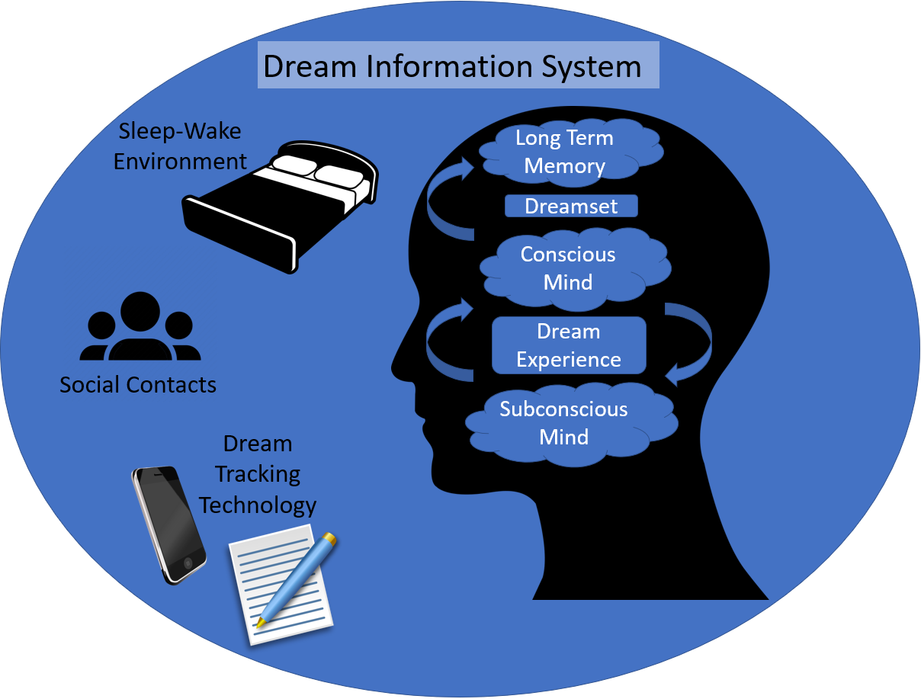

Slide 15
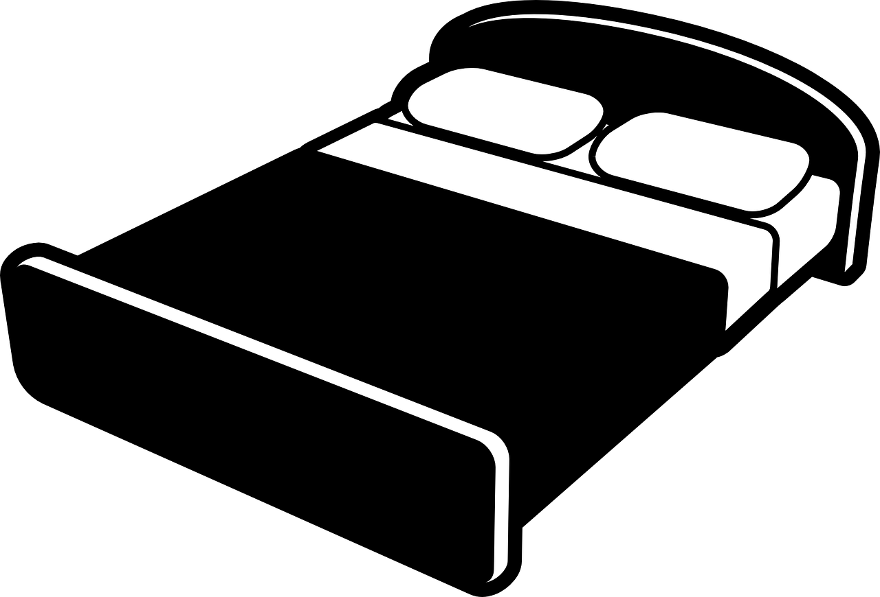
Sleep-Wake Environment
Recall primarily happens in the bedroom (76%)
Wake method varied from
Naturally/sun (67%)
Phone (65%)
Standalone alarm clock (7%)
Others/pets (27%)
Sleep-Wake Environment

Slide 16

Social Contacts
“I openly talk about them [dreams] nearly every day with friends and family‘’
-R142
Social Contacts
“Normally I wake up with pretty bad feelings after a nightmare and can take up to a whole day to emotionally recover. Going through the dream over and over again and telling it to people I know and trust helps me with feeling better”
-R162

Slide 17
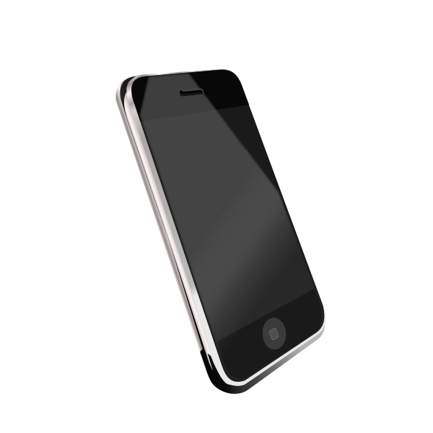

Dream Tracking Technology
“I have used multiple methods. I used to write down my dreams verbatim the moment I woke up. I eventually moved onto audio recordings on my phone because writing was tiresome upon waking up. I moved from audio recordings onto just trying to make mental notes and that works, but poorly and many dreams slip. I now write very short hand bullet points of events and feelings in a notepad physical or on my phone instead of full transcriptions and this is sufficient to reconstruct the dream later as necessary.”
-R134
Dream Tracking Technology

Slide 18
The Role of Technology
App review of current offerings (see paper!)
Respondents suggested many new features
Auto-tagging
Smart notifications (based on sleep cycle)
Multi-modal dream tracking (audio+text+drawing)
Storyboarding of events in dream
Help identify patterns in narratives

Slide 19
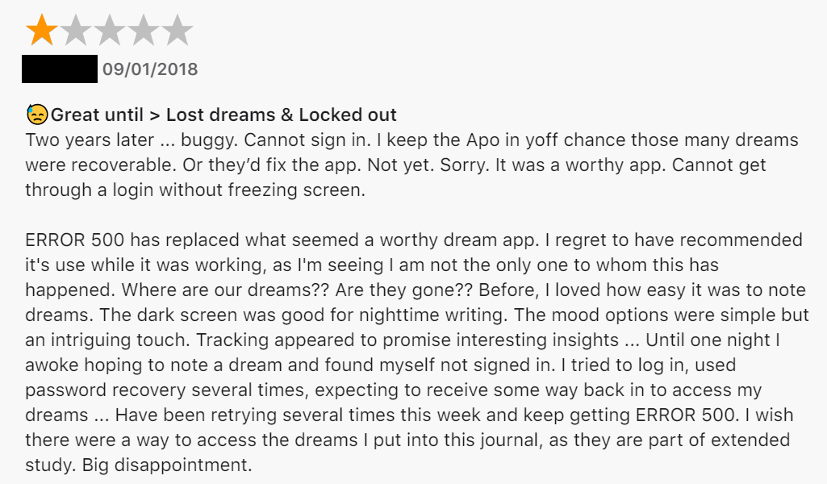
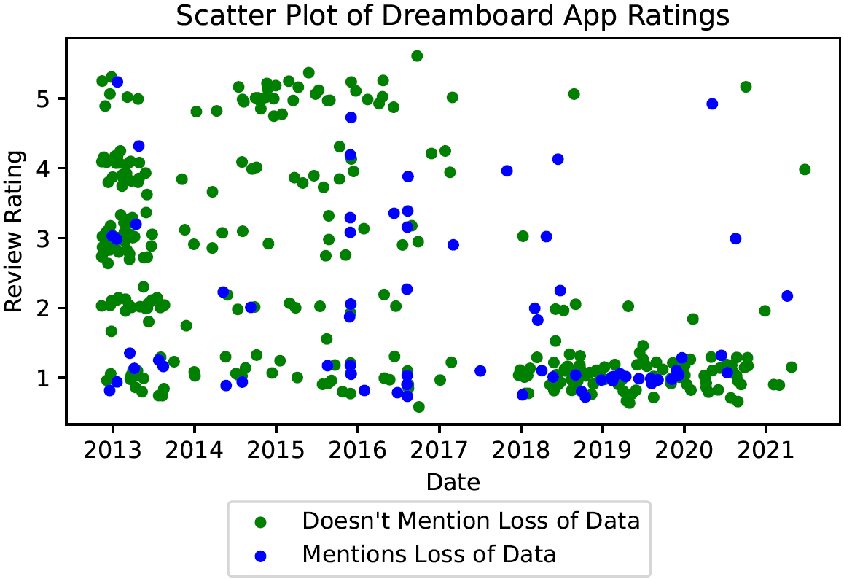
Underappreciated Personal Data
“The additional features not directly connected to note taking are obnoxious but I can't change the app out of fear of losing the stuff I've already written down”
-R158

Slide 20
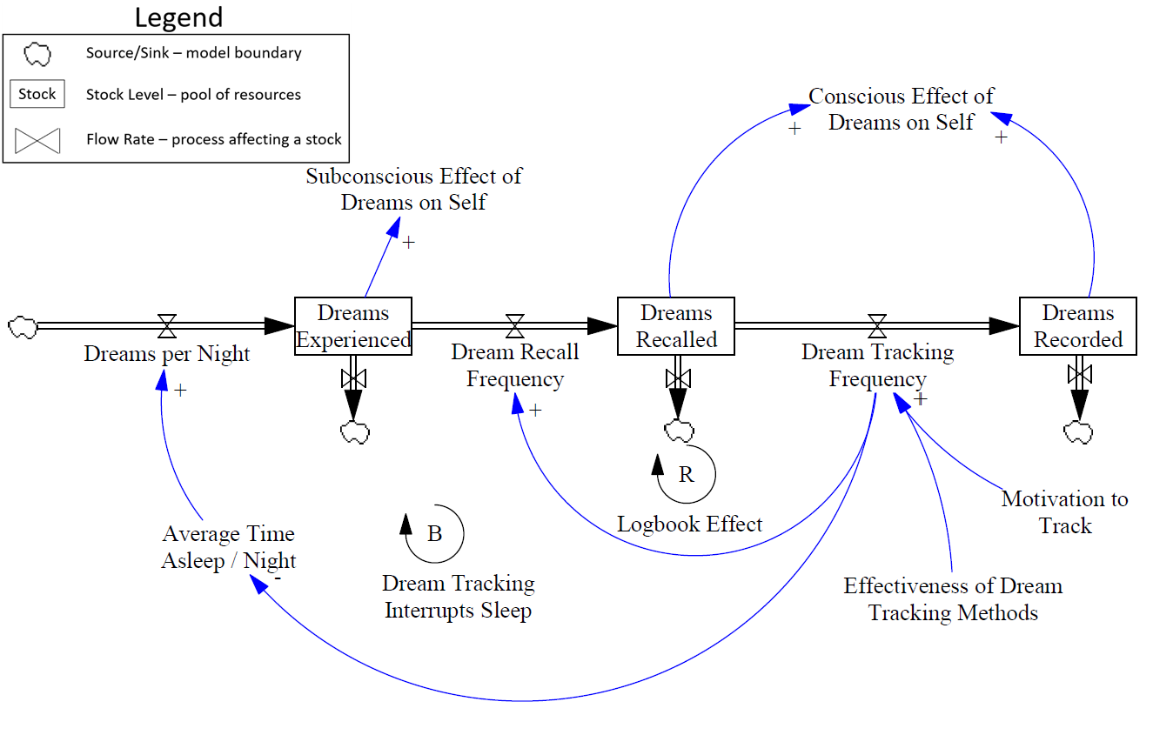
Dream Tracking Dynamics

Slide 21
Future Research in HCI
Interviews with clinicians utilizing dreamwork
Replicate therapist-guided methods with technology
Treating PTSD and nightmare disorder
Develop methods to make the most of the dreamset
New technology to help capture indescribable experiences
Community Dream Informatics

Slide 22

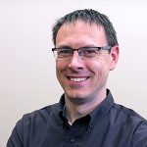


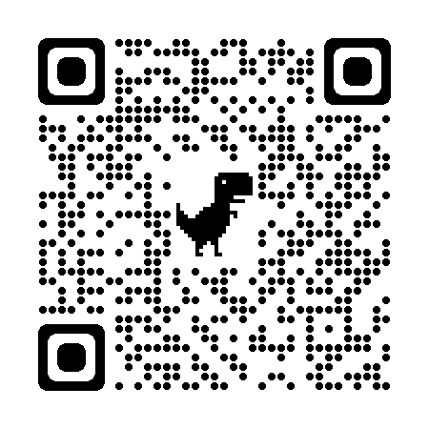
Thank you
Beverly Sears Graduate Research Fund
Professor Stephen Voida
Bryce Schumacher
Too Much Information Lab
Contact: Michael Hoefer
michael.hoefer@colorado.edu
twitter: @mjhoefer
michaelhoefer.com
Full Paper

Slide 25
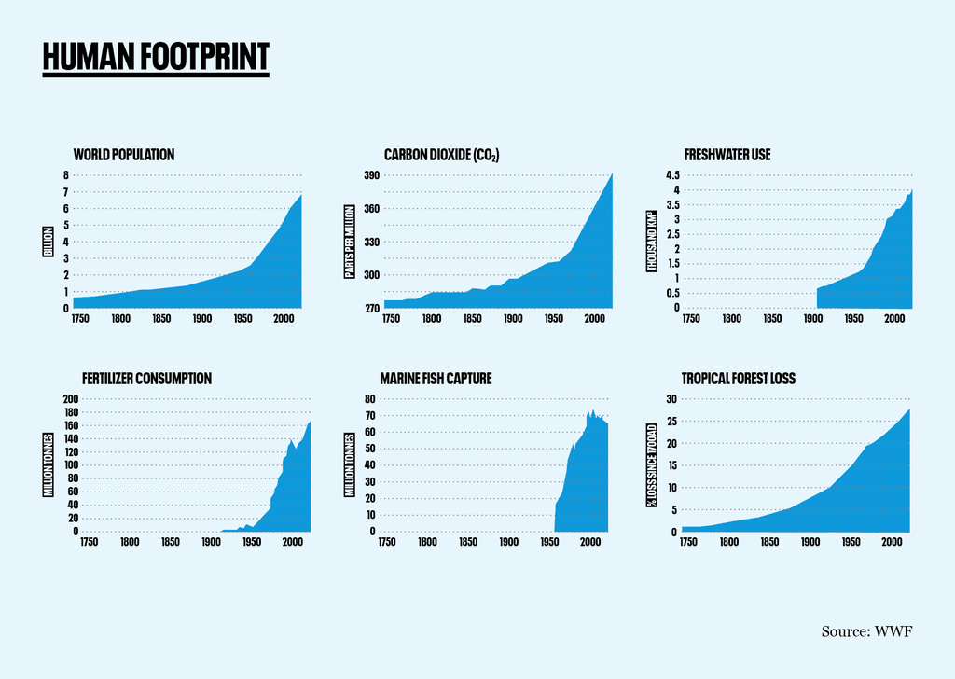
Nail Driven Hammer Development

Slide 26

“A point may soon be reached...when these needs are satisfied in the sense that we prefer to devote our further energies to non-economic purposes.”

Slide 27
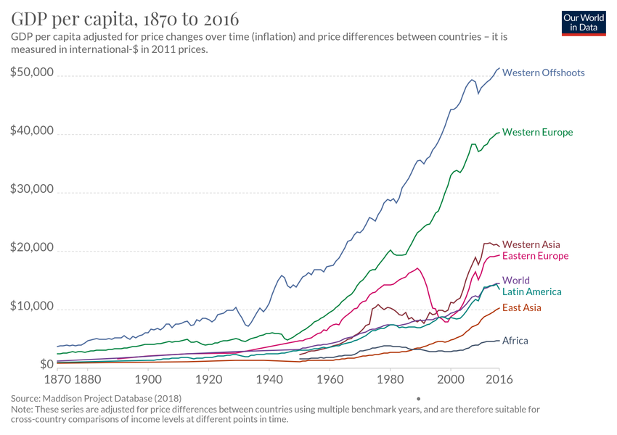

Slide 28
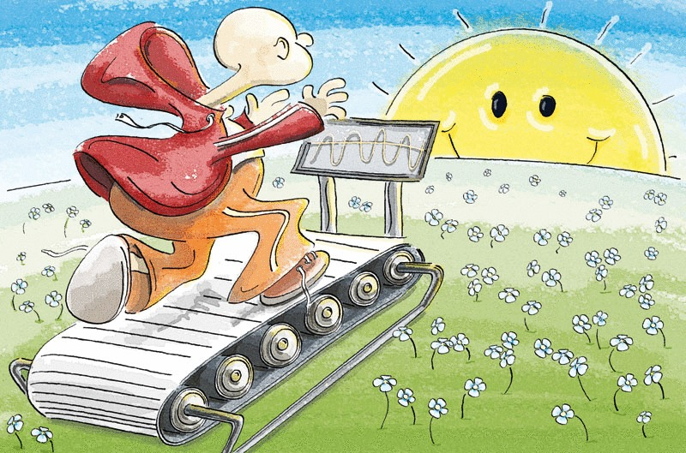
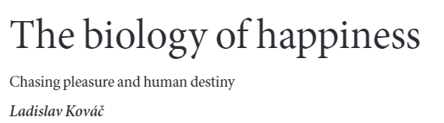

Slide 29
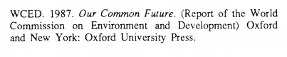
Challenge:
“Development that meets the needs of the present without compromising the ability of future generations to meet their own needs”

Slide 30
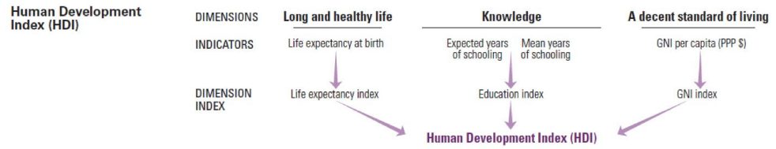
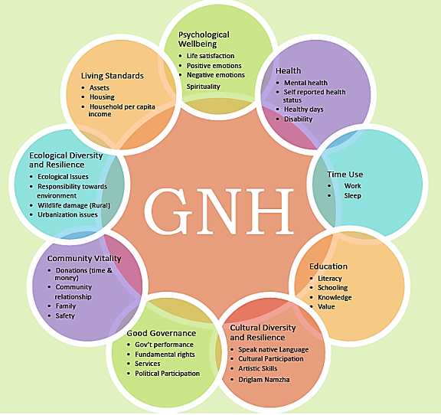
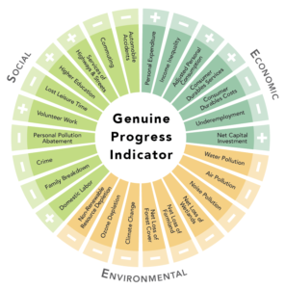
Alternative Development Metrics
Issues:
Inherent tradeoffs
Single numbers become meaningless
Provide little to no direction for improvement
Notes:
https://gnhusa.org/genuine-progress-indicator/

Slide 31
Approach:
Represent each individual not as a single node, but as an entire network

Slide 32
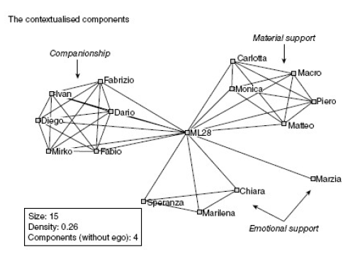
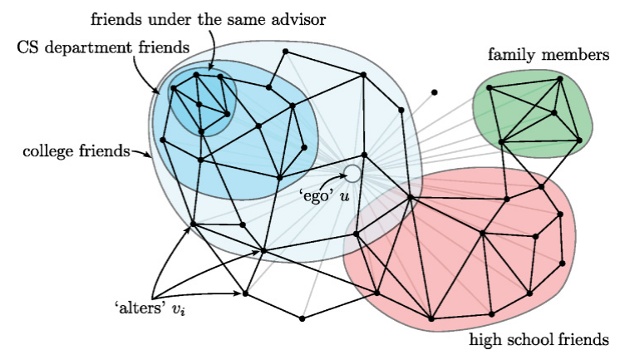
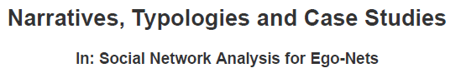

Tacit Assumption: Individual == Node
Notes:
Reasons why we might think this is the case:
Our bodies appear to be single objects, just like single nodes – the multiplicity is hidden inside our brains
The available data comes from systems where individuals are treated as distinct entities.

Slide 33
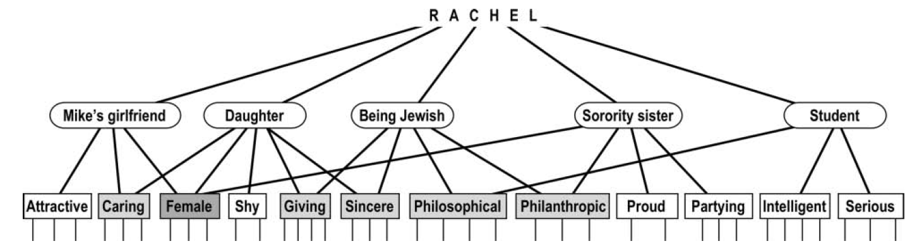
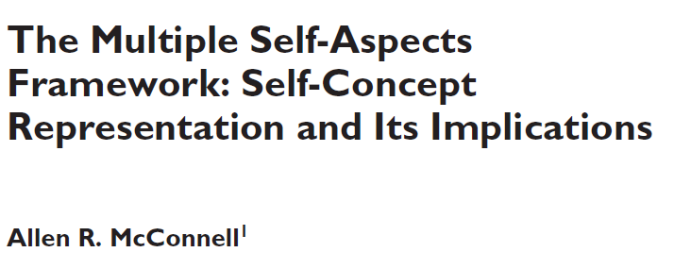
Possibility: Individual == Network

Slide 34
Possibility: Intra-Individual Ego Network
Elicited via systematic reflection

Slide 35
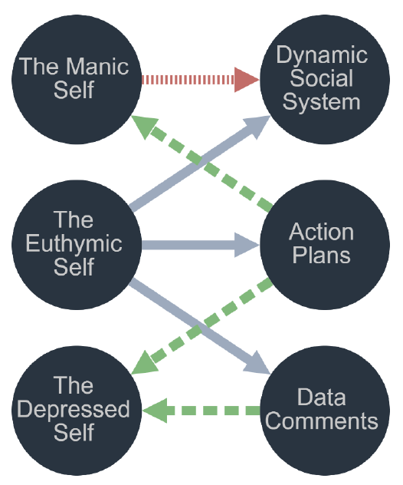
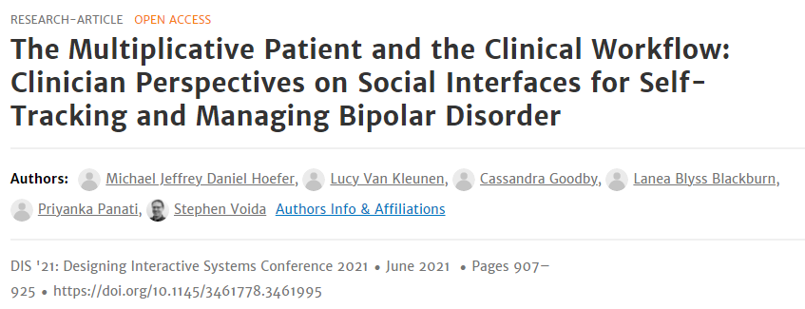
Possibility: Intra-Individual Ego Network

Slide 36
“Development that meets the needs of the present without compromising the ability of future generations to meet their own needs”

Slide 37
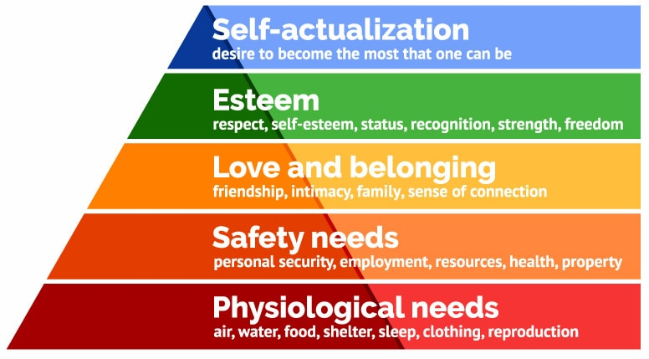
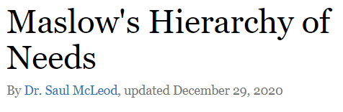
How do we measure need and satisfaction?

Slide 38
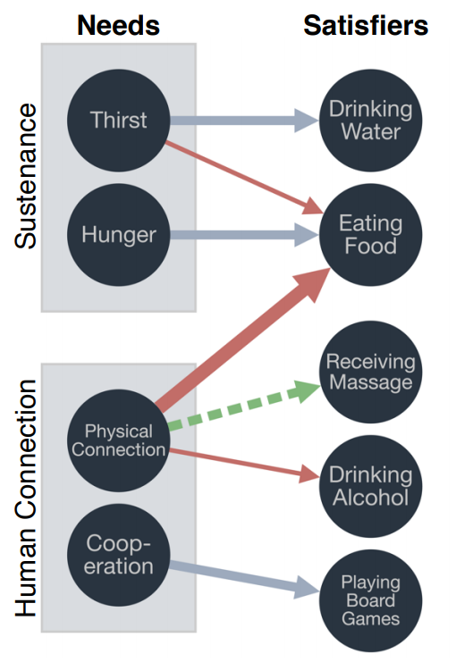
Intra-Individual Ego Network

Slide 39
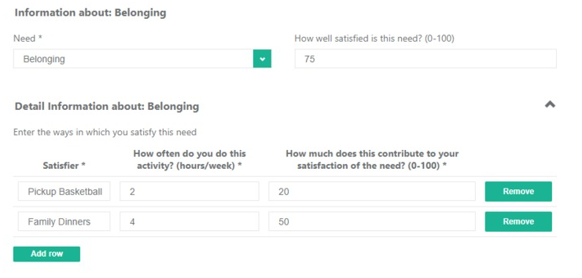
A New Kind of Data

Slide 40
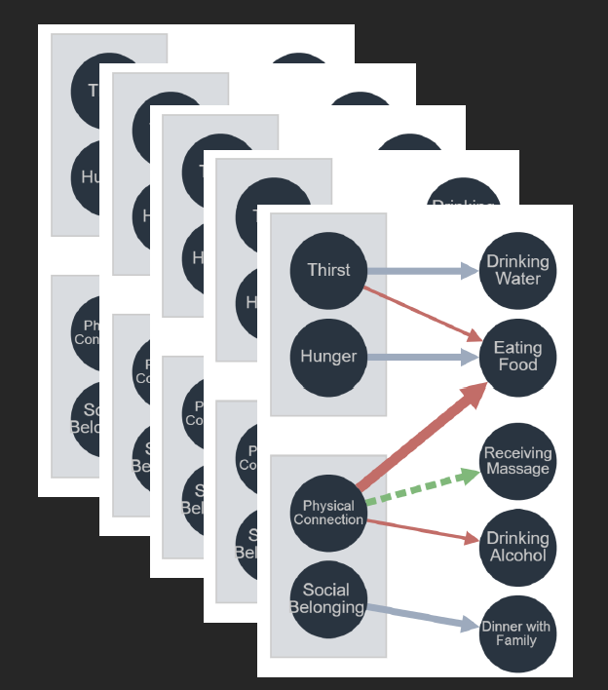
Multi-Layer Intra-Individual Ego Network

Slide 41
Represent each individual not as a single node, but as an entire network

Slide 42
Thank you

